Slide 1
Cannabis Pangenome
Brian J. Knaus¹, Todd P. Michael², Kelly J. Vining¹
¹Department of Horticulture, Oregon State University, Corvallis, OR 97331, USA
²The Plant Molecular and Cellular Biology Laboratory, The Salk Institute for Biological Studies, La Jolla, CA 92037, USA

Slide 2
Select Cannabis genomes from NCBI
Strain | Assembly | Size (Mbp) | N50 (Mbp) | Scaffolds | Busco | Citation
CBDRx | GCF_900626175.2 | 876.1 | 91.9 | 221 | 94.02 | Grassa et al. 2021
Cannbio-2 | GCA_016165845.1 | 914.3 | 91.4 | 147 | 97.08 | Braich et al. 2020
'jl' (Jilong; 吉隆) | GCA_013030365.1 | 812.5 | 82.9 | 483 | 92.69 | Gao et al. 2020
Finola | GCA_003417725.2 | 1009.6 | 77.1 | 2362 | 95.66 | Laverty et al. 2019
Purple Kush | GCA_000230575.5 | 891.9 | 60.9 | 6653 | 93.47 | Laverty et al. 2019
Purple Kush | GCA_000230575.1 | 892 | 0.1339 | 12836 | NA | van Bakel 2011

Slide 3
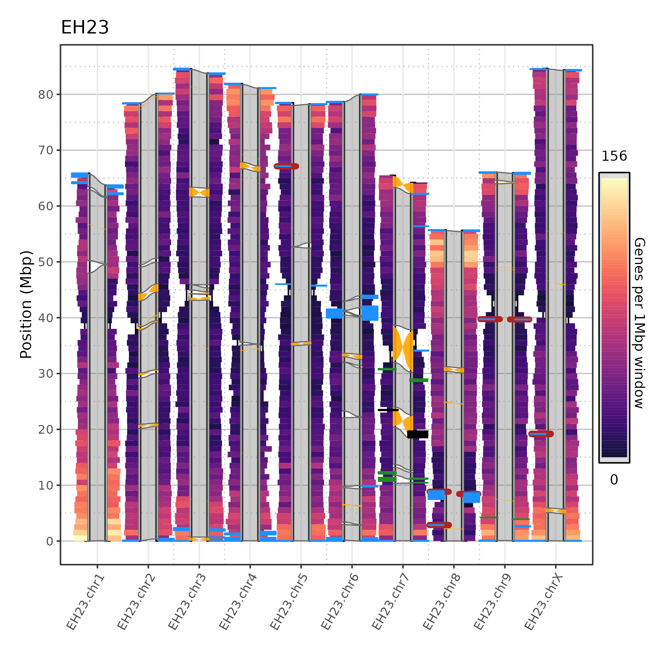

Slide 4
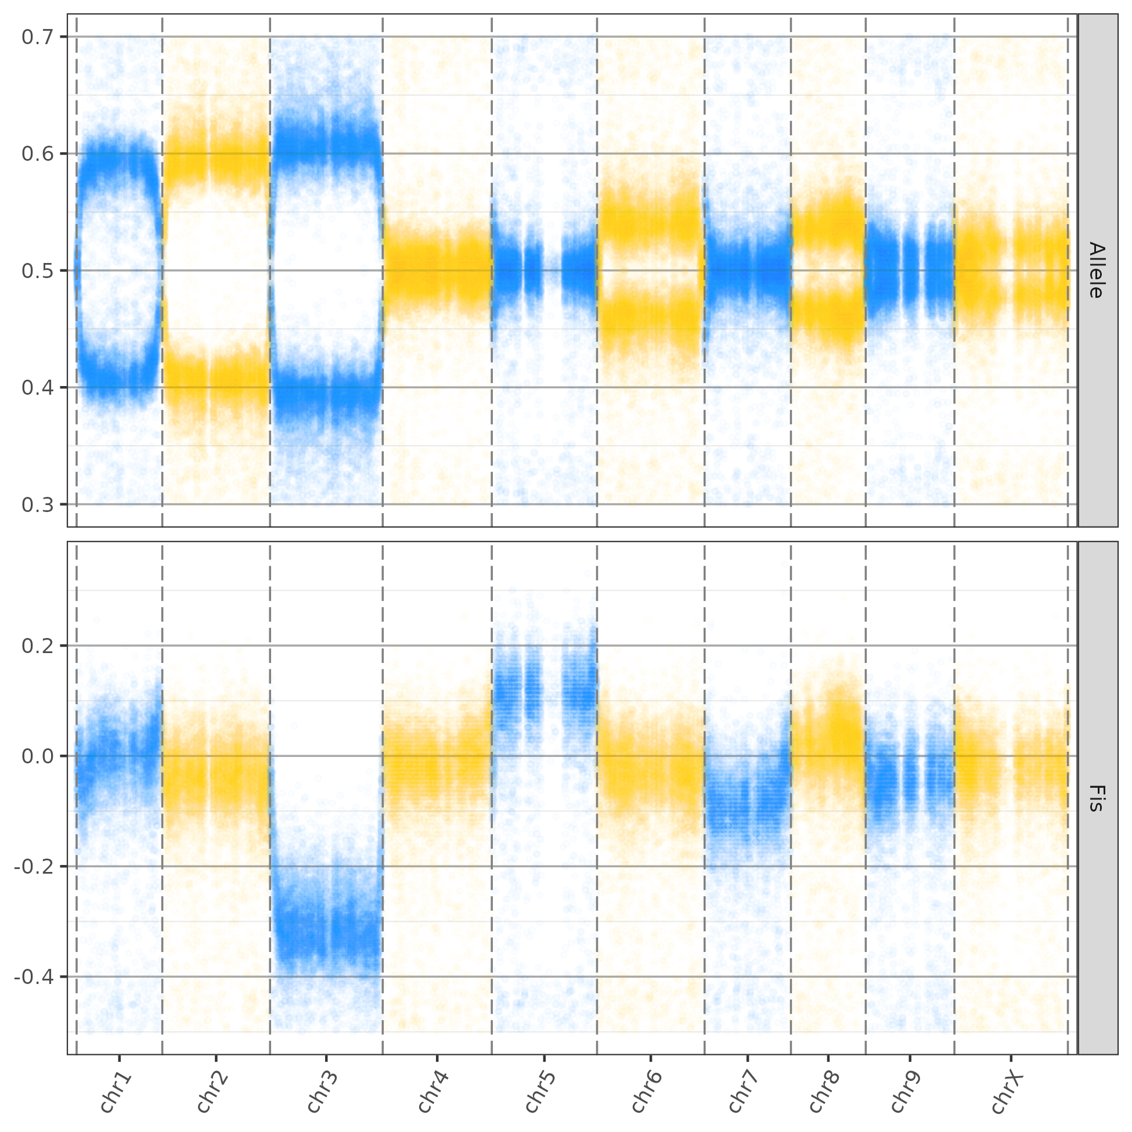

Slide 6
Cannabis Pangenome
39 scaffolded assemblies = 78 haplotypes
European hemp
Asian hemp
North American feral
Elite marijuana
Modern high cannabinoid hemp

Slide 7
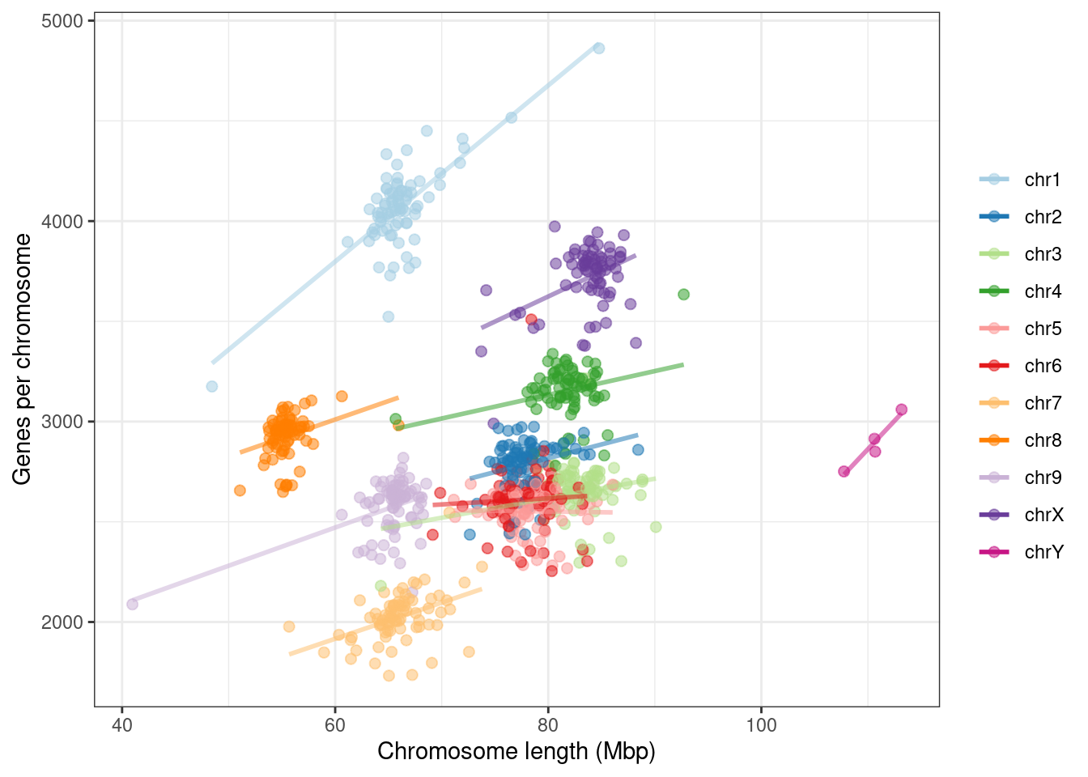

Slide 8
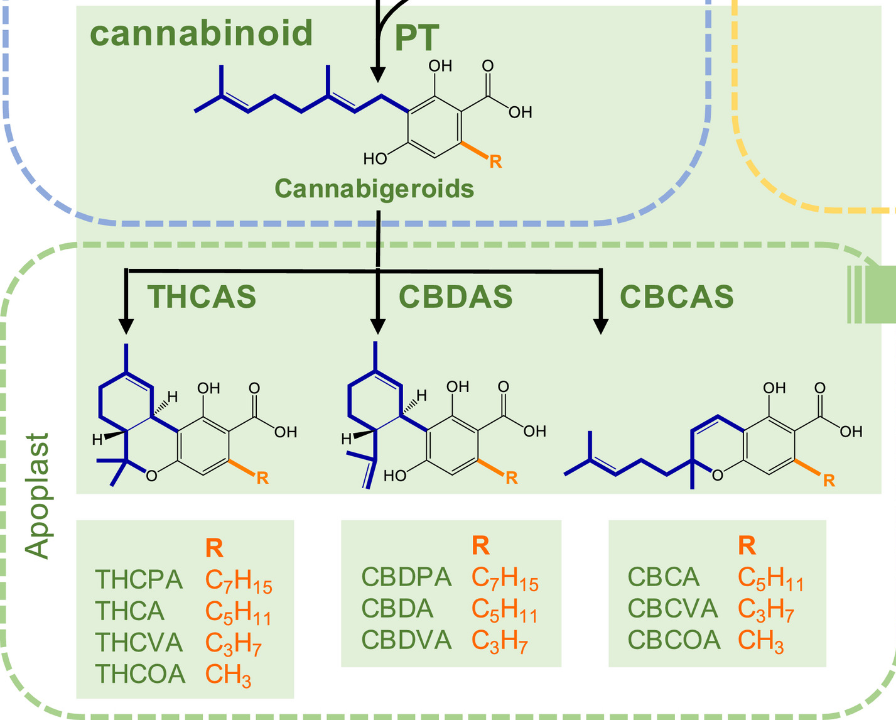
Cannabinoid pathway (Hurgobin et al. 2021)

Slide 9
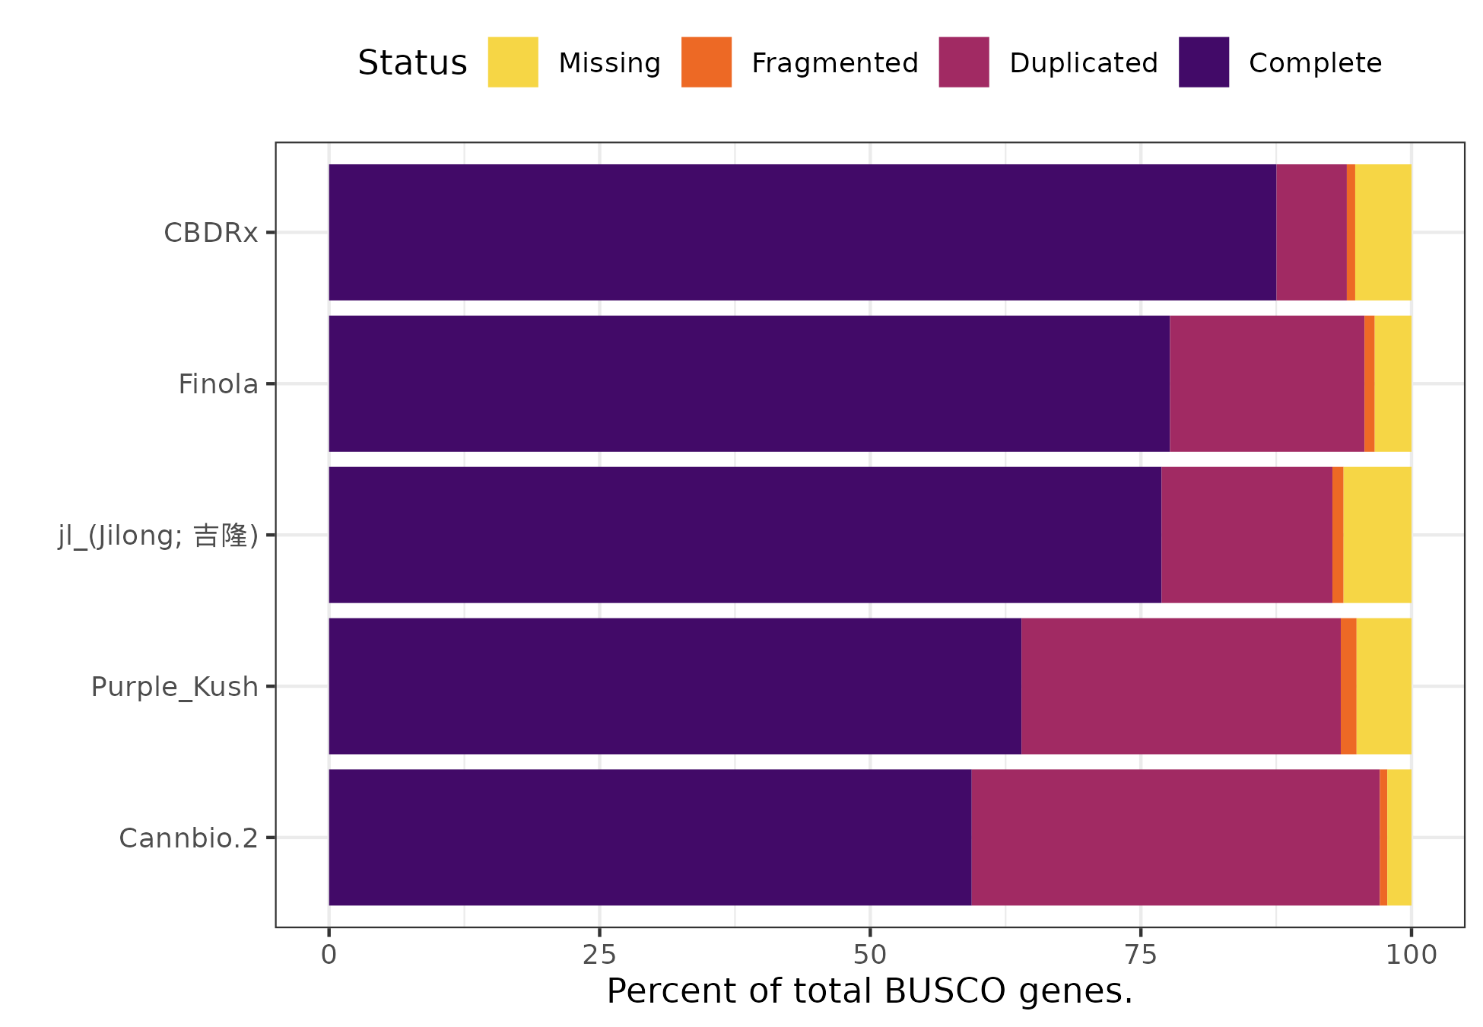
BUSCO

Slide 10
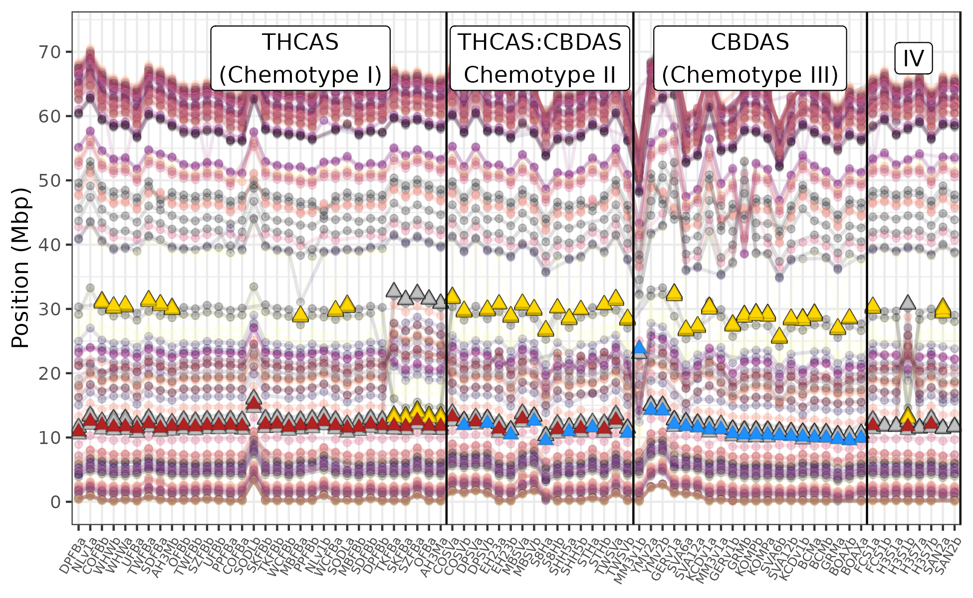
Cannabinoid synthases - chr7

Slide 11
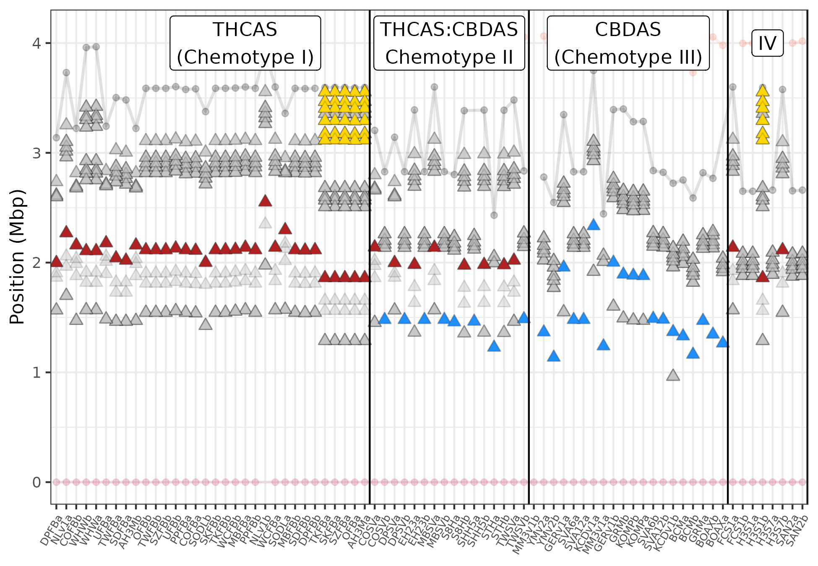
Cannabinoid synthases – chr7, zeroed on BUSCO_ID=127689at71240

Slide 12
Cannabinoid synthases
Chromosome 7, haplotypes are in columns, each point is the location of a BUSCO, lines connect the same BUSCO between haplotypes. Red triangles = THCAS (AB212829.1; Kojoma et al. 2006), blue triangles = CBDAS (AB292682.1; Taura et al. 2007), yellow triangles = CBCAS (LY658671.1; Page and Stout 2019), gray triangles = low specificity matches. High stringency matches are BLASTN hits at >98% identity with 0 gaps.
Kojoma, M., Seki, H., Yoshida, S., & Muranaka, T. (2006). DNA polymorphisms in the tetrahydrocannabinolic acid (THCA) synthase gene in “drug-type” and “fiber-type” Cannabis sativa L. Forensic science international, 159(2-3), 132-140.
Taura, F., Sirikantaramas, S., Shoyama, Y., Yoshikai, K., Shoyama, Y., & Morimoto, S. (2007). Cannabidiolic-acid synthase, the chemotype-determining enzyme in the fiber-type Cannabis sativa. FEBS letters, 581(16), 2929-2934.
Page,J.E. and Stout,J.M. CANNABICHROMENIC ACID SYNTHASE FROM CANNABIS SATIVA. Patent: KR 1020190025485-A 5 11-MAR-2019.

Slide 13
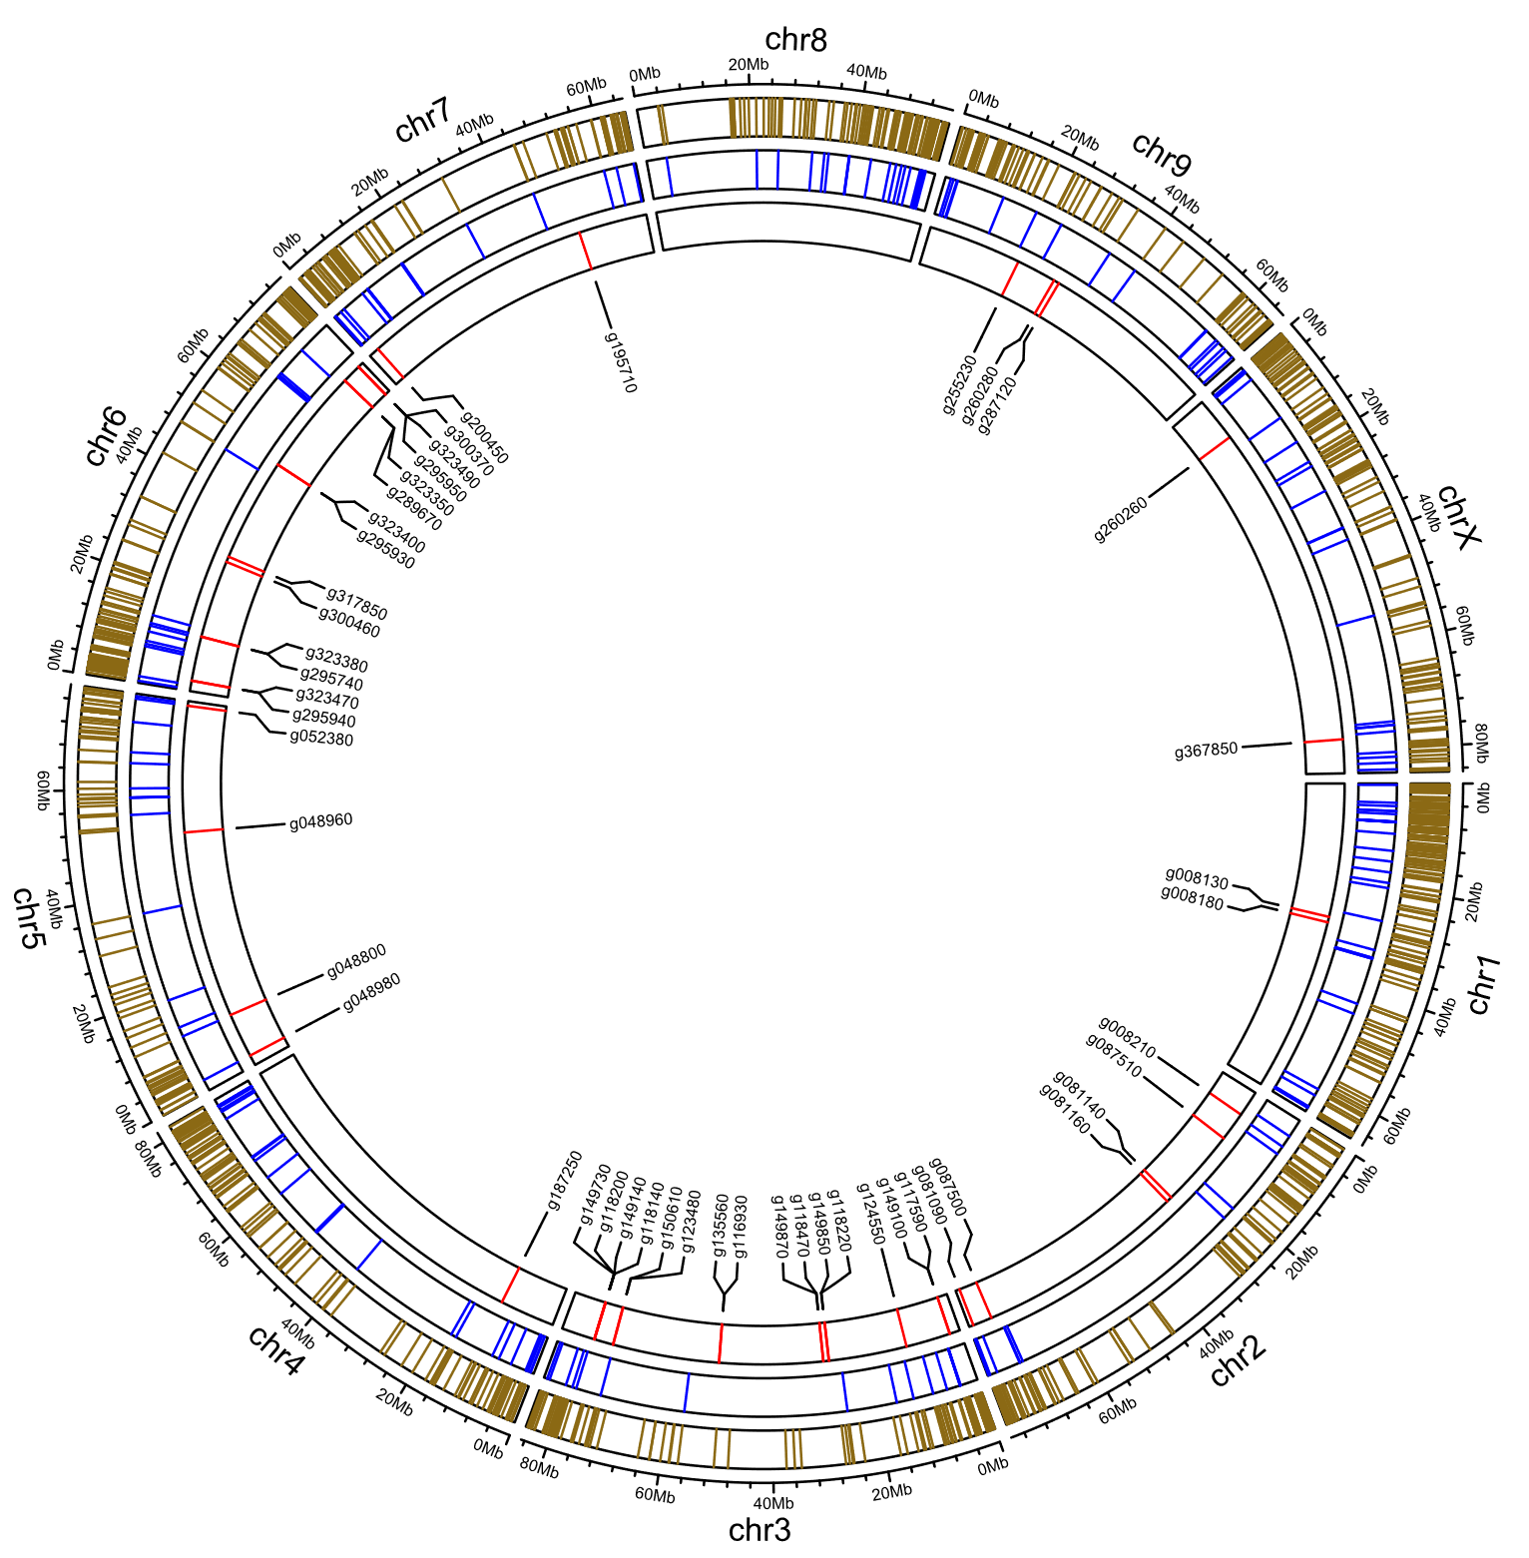
All categories
RLK
R genes most dense at 0-20 Mb on chr1
Most CNLs on chromosomes 3 and 6
CNL
EH23a
R gene subcategories:
Receptor-like kinases,
Coiled-coil NLR genes

Slide 14
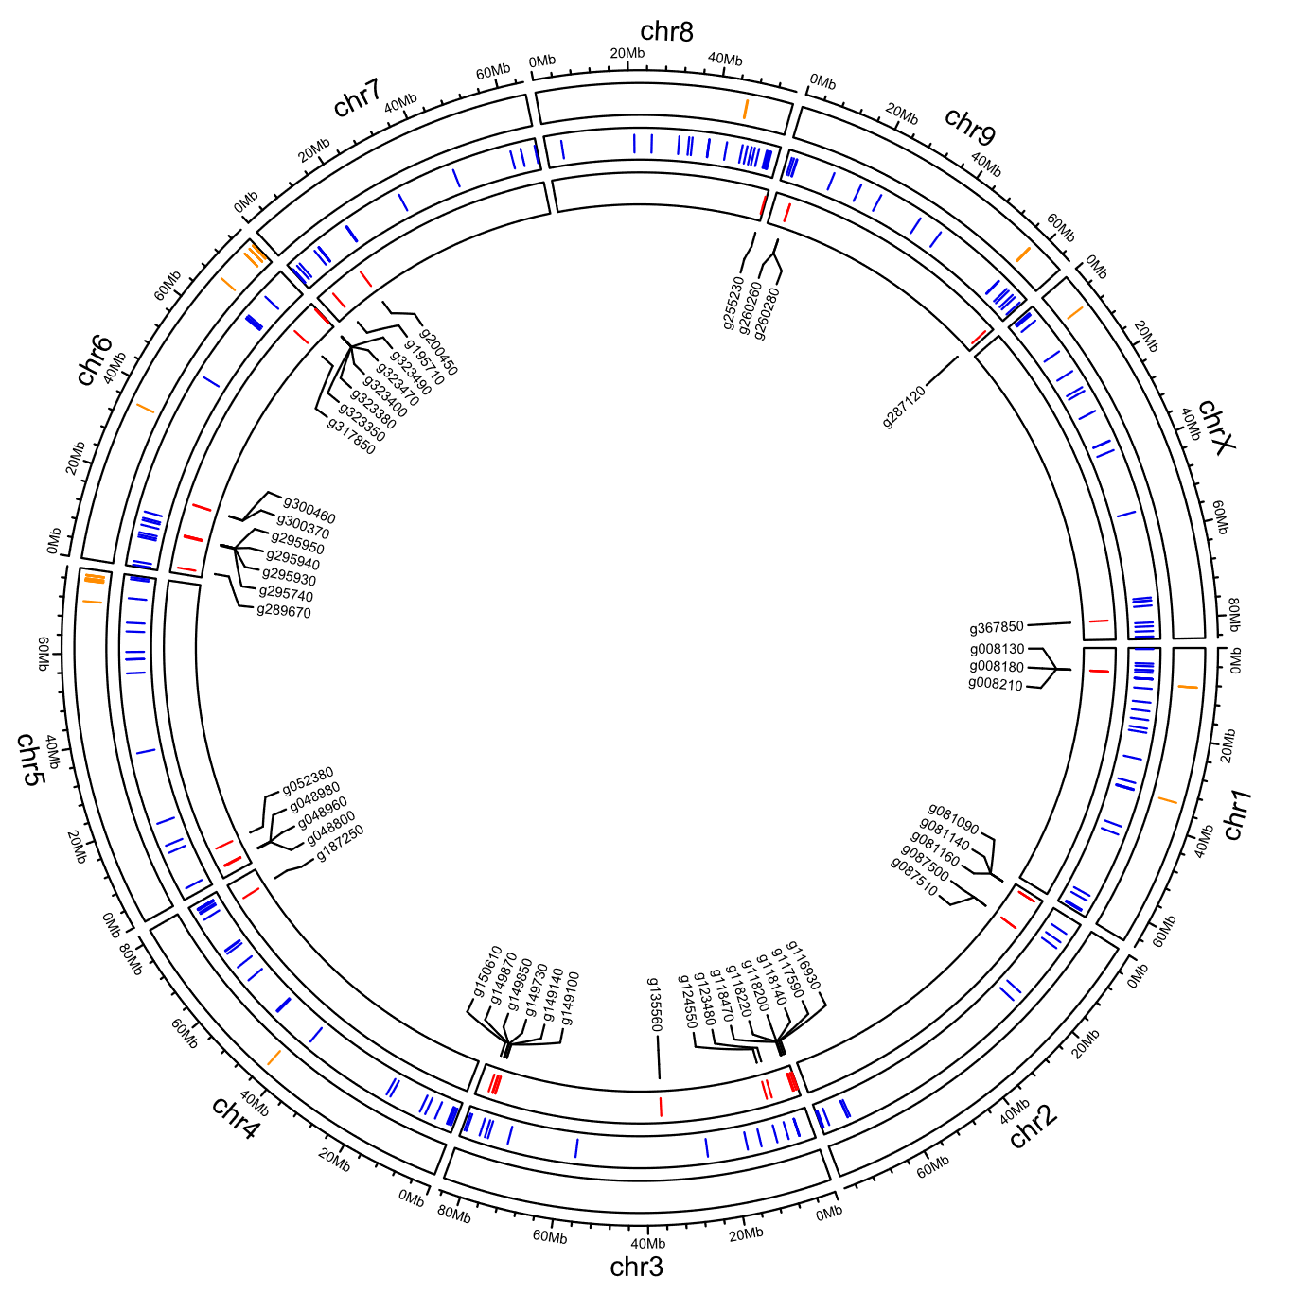
R genes and terpene synthases
EH23a
TPS
RLK
CNL

Slide 15
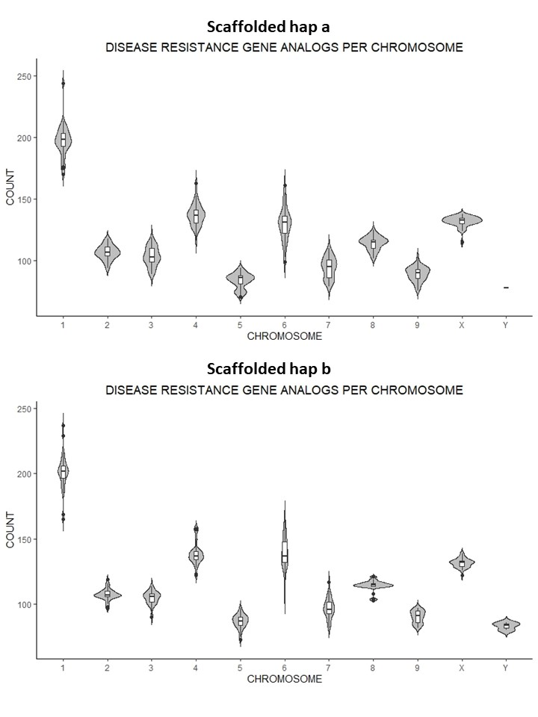
Haplotype a
Range of R genes per chromosome
Haplotype b

Slide 16

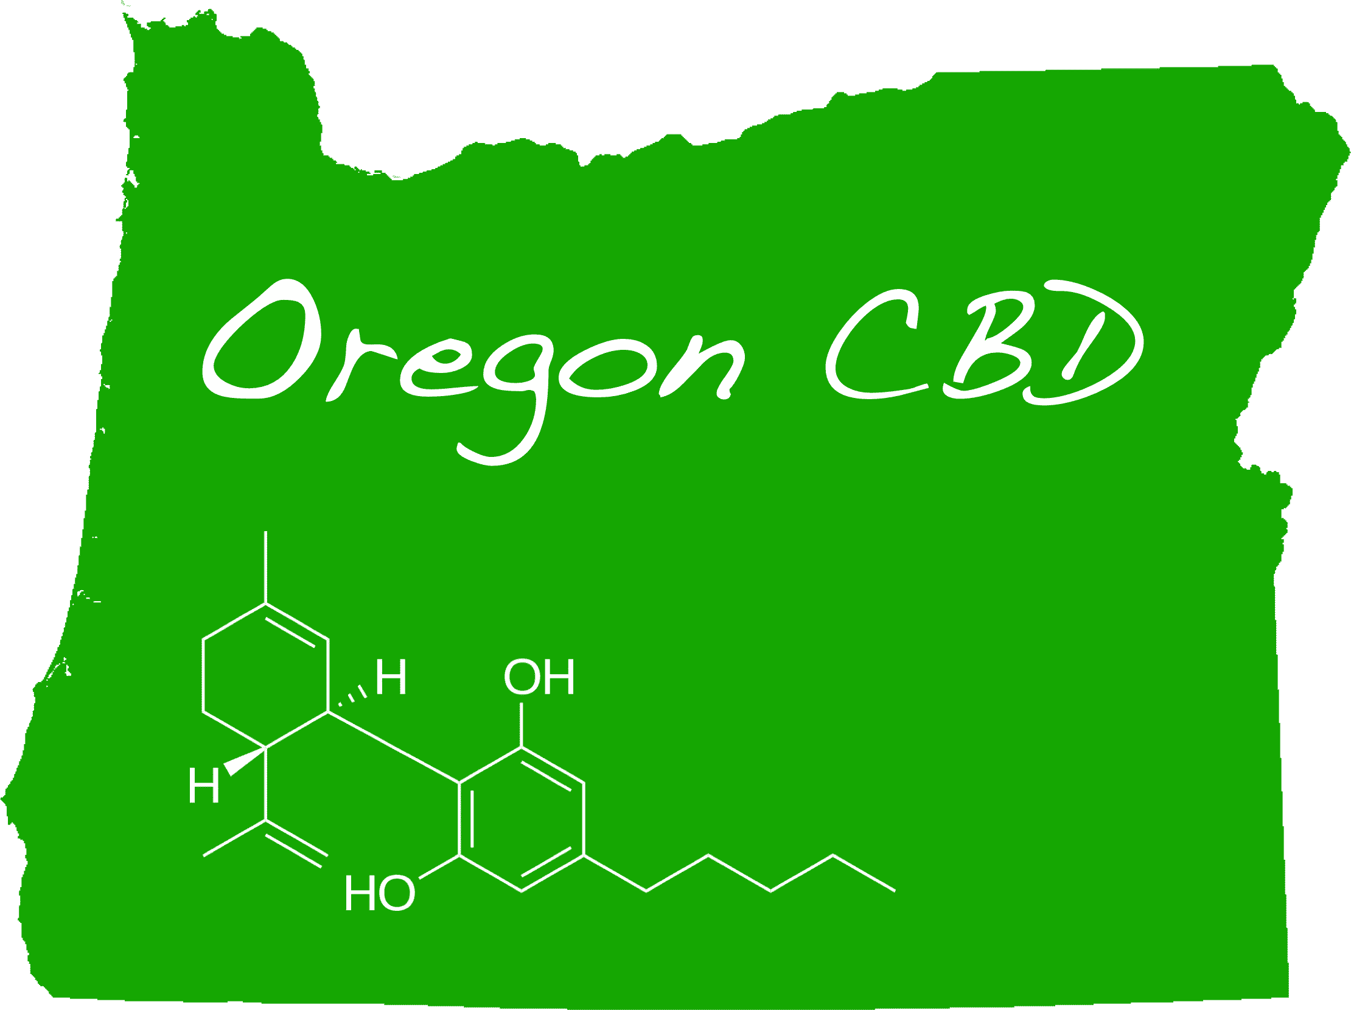

Acknowledgments
OregonCBD: Seth Crawford, Eric Crawford, Andrea Garfinkel, Aaron Trippe
Michael Lab: Todd P. Michael, Ryan C. Lynch, Lillian K. Padgitt-Cobb, Nolan T. Hartwick, Nick Allsing, Anthony Alyward, Allen Mamerto, Justine Kitony, Kelly Colt

Slide 18
Cannabis Genomics
Profiles of disease resistance genes in the Cannabis pangenome – Kelly Vining
Hybrid origins of Cannabis sativa – Ryan Lynch

